Slide 1
Cloud Computing: Task Parallel Computing
Vijay Dialani, PhD
Boise State University
vijaydialani@boisestate.edu
©All rights reserved by the author

Slide 2
Some things to catch up …
Example of session management in Web Servers:
http://www.cs.gmu.edu/~offutt/classes/642/slides/642Lec10b-JSP-stateHandling.pdf
Example of tomcat container when hosting a web service

Slide 3
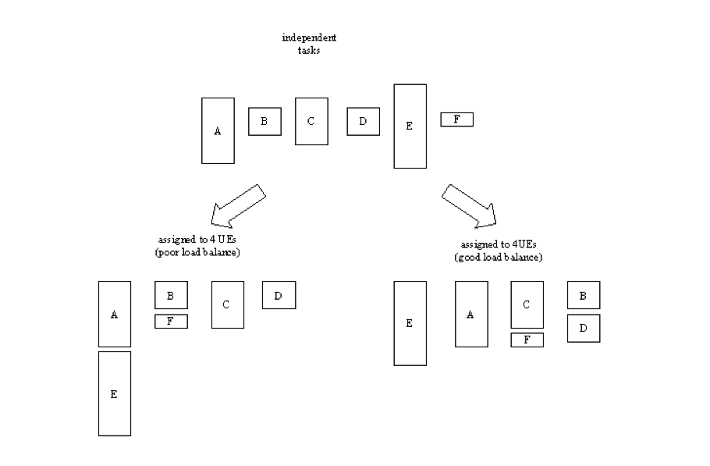
What is task parallelism?
https://blackboard.boisestate.edu/webapps/portal/frameset.jsp?tab_tab_group_id=_2_1&url=%2Fwebapps%2Fblackboard%2Fexecute%2Flauncher%3Ftype%3DCourse%26id%3D_62145_1%26url%3D

Slide 4
Properties of Task Parallelism
Each Task is independent of others
Each Task can be randomly allocated to any of the processing units
System is elastic
Resilient to failure of nodes
Resilient to addition of new nodes
If idempotent - each task can be simultaneously scheduled on multiple nodes
To provide resilience
To provide guarantees on completion

Slide 5
Which are the allocation modes for the tasks?
Round Robin
All nodes are arranged in a circular array
Each incoming request increments the pointer and allocates the request to next node
Least Loaded
All nodes describe their current load in terms of either:
Number of pending task
Estimated time for completion
Least loaded node is selected for processing the request
Consistent hash allocation
A field from the incoming request is chosen to identify the hash code
A DHT(Distributed Hash Table) is used to allocate the hash code to the node serving the range.
Chord: A Scalable Peer-to-peer Lookup Service for Internet Applications
http://pdos.csail.mit.edu/papers/chord:sigcomm01/chord_sigcomm.pdf

Slide 6
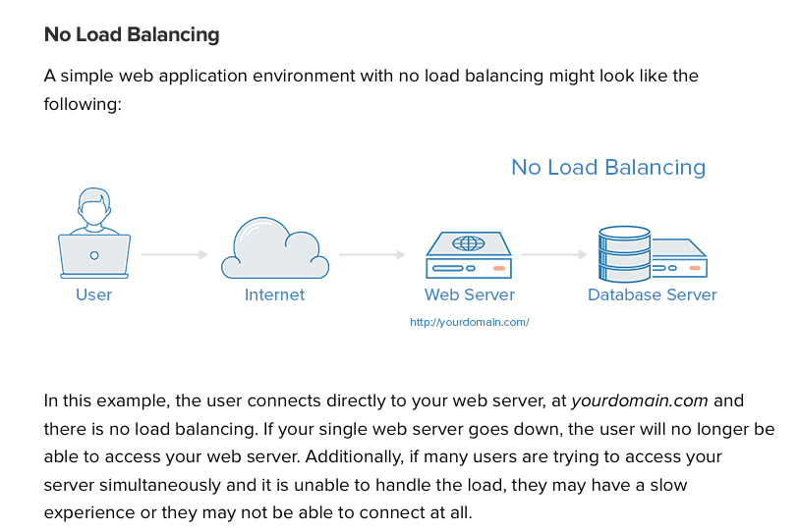
JAX-RS and Load Balancing

Slide 7
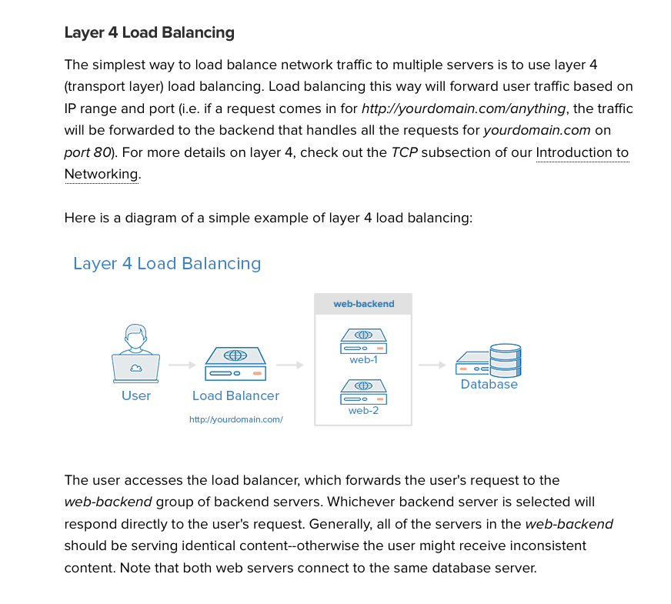
JAX-RS and Load Balancing

Slide 8
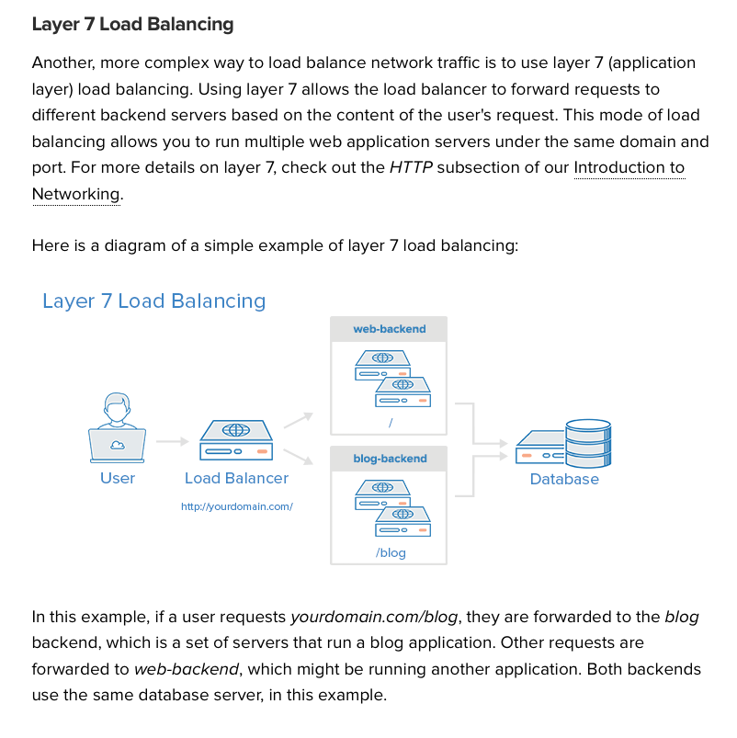
JAX-RS and Load Balancing

Slide 9
Example HAProxy based code in git chapter4
Special Thanks to:
https://www.digitalocean.com/community/tutorials/an-introduction-to-haproxy-and-load-balancing-concepts
http://www.haproxy.org

